Slide 1
Identification of Key Biomarkers in Diabetic Foot Ulcer complications and Exploring their Potential Clinical Implications
Name : Latchitha J R
Date : 10.11.1024

Slide 2
PROBLEM STATEMENT
Problem statements:
Diabetic Foot Ulcers (DFUs) affect around 15% of diabetic patients, leading to serious complications like amputation, due to infection or severe tissue damage
DFUs are challenging to heal, often resulting in prolonged treatments and recurrent ulcerations due to its chronic nature
Treatment for such biofilm infections becomes a challenge whenyhe condition has developed resistance to multiple antimicrobial drugs.
Of the estimated 537 million people worldwide who have diabetes, 19% to 34% will develop a Diabetic Foot Ulcer (DFU) in their lifetime . Approximately 20% of people who develop a DFU will require lower-extremity amputation and 10% will die within 1 year of their first DFU diagnosis (International Diabetes Federation, 2020) .

Slide 3
Impact on Stakeholders: .
DFUs cause pain, limited mobility, and a high risk of amputation, affecting quality of life and independence.
DFUs require intensive resources, including specialized wound care and infection control, straining provider capacity.
High treatment costs and prolonged hospital stays due to DFUs contribute to financial burdens on healthcare systems.

Slide 4
INTRODUCTION
Purpose of the Project:
To investigate the underlying mechanisms of diabetic foot ulcers (DFUs) and explore effective treatment strategies to improve healing and reduce complications.
Emphasis on biofilm-associated infections, neuropathy, and vascular issues that contribute to DFU formation and chronicity.
Develop targeted therapeutic approaches to reduce the incidence of amputations and enhance patient quality of life.

Slide 5
Importance of the Project:
Current treatments struggle against biofilm resistance and chronic wound healing; innovative therapies are essential.
Reducing DFU-related complications like infection and amputation can alleviate healthcare costs and improve patient outcomes, making it a critical research area.

Slide 6
Background on Diabetic Foot Ulcers (DFUs)
DFUs are chronic, non-healing wounds that occur in diabetic patients due to neuropathy, poor circulation, and immune impairment.
Untreated DFUs often lead to infections, amputations, making them a serious diabetic complication.
Treating DFUs requires extensive resources, including specialized wound care and repeated hospitalizations, contributing to high healthcare costs.
Due to their chronic nature and infection susceptibility, DFUs require innovative treatment approaches to improve healing and prevent severe outcomes

Slide 7
OBJECTIVES
Identification of biomarker from datasets of diabetic foot ulcer from Gene Expression omnibus (GEO) database
Analysing the dataset by computing fold change between control and diseased sample and conducting two tailed test.
Identifying signifcant genes based on the set thresholds for fold change and two tailed test value

Slide 8
4. To perform functional annotations of significant genes using DAVID tool
5.Identifying pathways and GO terms of the annonated significant genes.
6. Exploring Potential Clinical significance through ClinicalTrials.gov website
7. Data visualization using Tableau of annotated data set

Slide 9
DATA COLLECTIONS
Primary Data Source:
Gene Expression Omnibus (GEO) Database: Accessed public datasets on diabetic foot ulcer (DFU) gene expression.
Data Analysis Tools:
Statistical Analysis: Computed fold change between control and DFU samples to quantify gene expression differences.
Two-Tailed Test: Conducted to identify statistically significant genes, applying thresholds to select relevant results.
Functional Annotation: DAVID tool used for enrichment analysis of significant genes, identifying pathways and Gene Ontology (GO) terms.
Data Visualization:
Tableau: Created visualizations for annotated data, summarizing gene expression, pathways, and GO terms for clear interpretation.

Slide 10
Inclusion Criteria:
Dataset Selection Criteria:
Sample Type: Datasets containing diabetic foot ulcer (DFU) samples with controls
Source: Skin biopsies from patients with diabetic foot ulcers (DFUs) and healthy controls.
Cell Type: Human dermal microvascular endothelial cells (HDMECs) isolated for analysis.
Study Design: Expression Profiling: Conducted RNA sequencing (RNA-seq) for high-throughput gene expression profiling.
Comparative Analysis: Designed to identify differential gene expression patterns between DFU-affected and healthy HDMECs.
Gene Selection Criteria:
Fold Change Threshold: Set a minimum fold change threshold of >2 to prioritize genes with substantial expression differences.
Statistical Significance: Only genes with p-values <0.05 in the two-tailed test were considered significant.

Slide 11
DATA ANALYSIS
Data Analysis: Analytical Methods Used
Gene Expression Analysis:
Fold Change Calculation: avg. of diseased sampes / avg. of control samples
Statistical Testing: Two-Tailed T-Test: to identify statistically significant genes, focusing on genes with p-values <0.05 to minimize false values
Functional Annotation:
DAVID Tool: Used to analyze significant genes for enriched pathways and Gene Ontology (GO) terms
Clinical Significance Exploration:
Cross-Referencing with ClinicalTrials.gov: Checked significant genes and pathways against ongoing or completed clinical trials
Data Visualization:
Tableau: Visualized annotated data to clearly present gene expression changes, pathway involvement, and GO terms, aiding in interpreting results.

Slide 12
Contribution to Interpretation
Clarifying Biomarker Potential:
Fold change and T-test provided a focused list of potential biomarkers
Pathway and Functional Insights:
DAVID annotations clarified the biological processes and pathways associated with DFU, such as inflammation, angiogenesis, and immune response, linking them to the pathology of DFU.
Clinical Application:
Identified genes and pathways already under clinical investigation, guiding future therapeutic development strategies for DFU.
Enhanced Data Interpretation:
Visually mapping gene expression changes and pathway involvement, data-driven conclusions on DFU biomarkers.

Slide 13
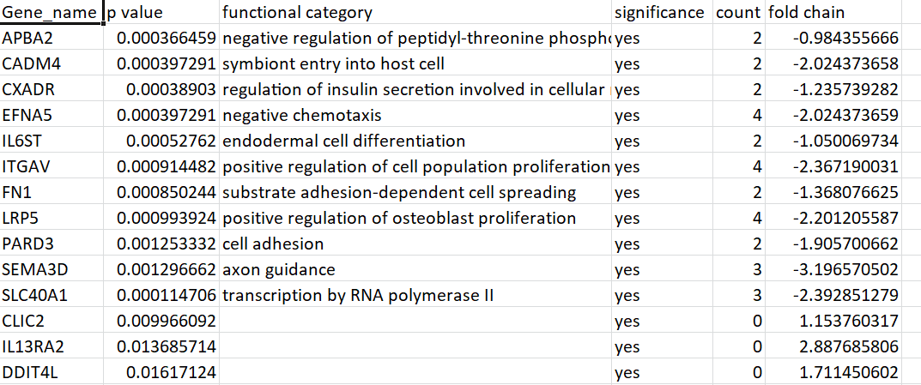
RESULTS
Top identified biomarkers to treat DFU

Slide 14
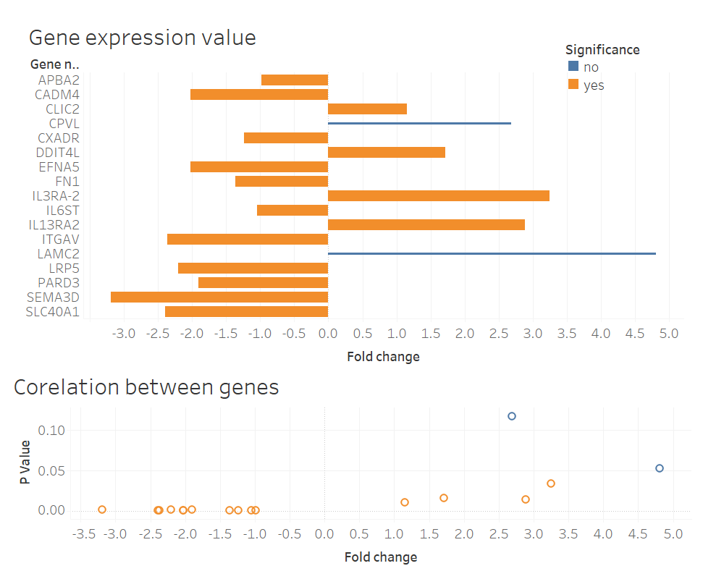
Interpretation of annotated data through Tableau

Slide 15
CLINICAL SIGNIFICANCE
s.no | Gene_id | Key findings | Potential clinical significance
1. | APBA2 | linked to neuronal signaling | May influence DFU through inflammatory modulation
2 | CADM4 | vital roles in cell adhesion and implications in epithelial integrity. | May enhance wound repair by stabilizing cellular adhesion, potentially reducing DFU progression.
3 | CXADR | Known for encoding the coxsackievirus and adenovirus receptor; involved in cell adhesion. | Could influence immune responses and facilitate wound healing in DFU patients.
4 | EFNA5 | Plays a role in angiogenesis | Promotes blood vessel formation, potentially aiding DFU healing by improving blood flow in affected areas.

Slide 16
s.no | Gene_id | Key findings | Potential clinical significance
5 | IL6ST | IL6ST gene polymorphisms have been linked to inflammatory diseases. | Modulates inflammatory response, which could reduce excessive inflammation in DFU and promote balanced healing.
6 | ITGAV | Involved in cell adhesion, migration, and angiogenesis; some studies support its role in wound repair and revascularization in ischemic conditions. | May support DFU healing by enhancing cell adhesion and vascularization, important in tissue repair.
7 | FN1 | Fibronectin 1 is essential for cell adhesion, tissue repair, and wound healing. Clinical studies show a significant role in extracellular matrix formation in chronic wounds. | extracellular matrix formation and tissue repair, potentially critical in DFU wound healing.
8 | LRP5 | Associated with bone density and vascular health | May indirectly aid DFU treatment by supporting vascular health and thus better blood supply to wound areas.

Slide 17
s.no | Gene_id | Key findings | Potential clinical significance
9 | PARD3 | Involved in cell polarity and tissue organization; | Could support wound closure by promoting organized cellular proliferation and migration, essential in wound healing processes.
10 | SEMA3D | SEMA3D has roles in vascular patterning and nerve guidance; studies indicate potential involvement in vascularization and nerve health in wound repair | May promote new blood vessel growth in DFU, improving blood flow and nerve health, which are often compromised in diabetic wounds.
11 | SLC40A1 | Involved in iron transport; mutations linked to iron overload disorders. Limited direct research on DFU | Iron homeostasis is crucial in wound healing; SLC40A1 may influence DFU by regulating iron levels, reducing oxidative stress and promoting healing.

Slide 18
LIMITATIONS:
Limitations in Gene Expression and DFU
Data Heterogeneity with Varying sample quality, diverse patient populations, and inconsistent data collection methods across studies in GEO database
Limited specificity in gene ontology (GO) terms can lead to broad, less-informative categories from annotation tool, DAVID
Many clinical trials focus on broader diabetic complications rather than DFU-specific gene targets from ClinicalTrials.gov website

Slide 19
Impact on results
Heterogeneous data sources and limited DFU-focused datasets reduce the applicability of findings specifically to DFU treatment.
Lack of DFU-targeted clinical trials and gene-specific outcomes limits the depth of conclusions regarding treatment impacts.

Slide 20
CONCLUSION
Recap of Findings
Key biomarkers identification for diabetic foot ulcer (DFU) identified from GEO datasets.
Significant genes analysis by fold change and two-tailed tests.
Pathways and GO terms of significant genes identified via DAVID tool.
Potential clinical significance explored through ClinicalTrials.gov.
Key findings visualized with Tableau for clarity.

Slide 21
Future Directions
Validation and Clinical Application
Experimental validation of identified DFU biomarkers.
Investigate clinical relevance and applications for identified genes.
In-depth Analysis and Visualization
Conduct detailed pathway analysis for biological insights.
Utilize advanced tools for clearer data interpretation.

